Slide 1
Veri Bilimi : Python ile Uygulamalı Doğal Dil İşleme
Embeddings
11 Mayıs 2023
Notes:
..

Slide 2
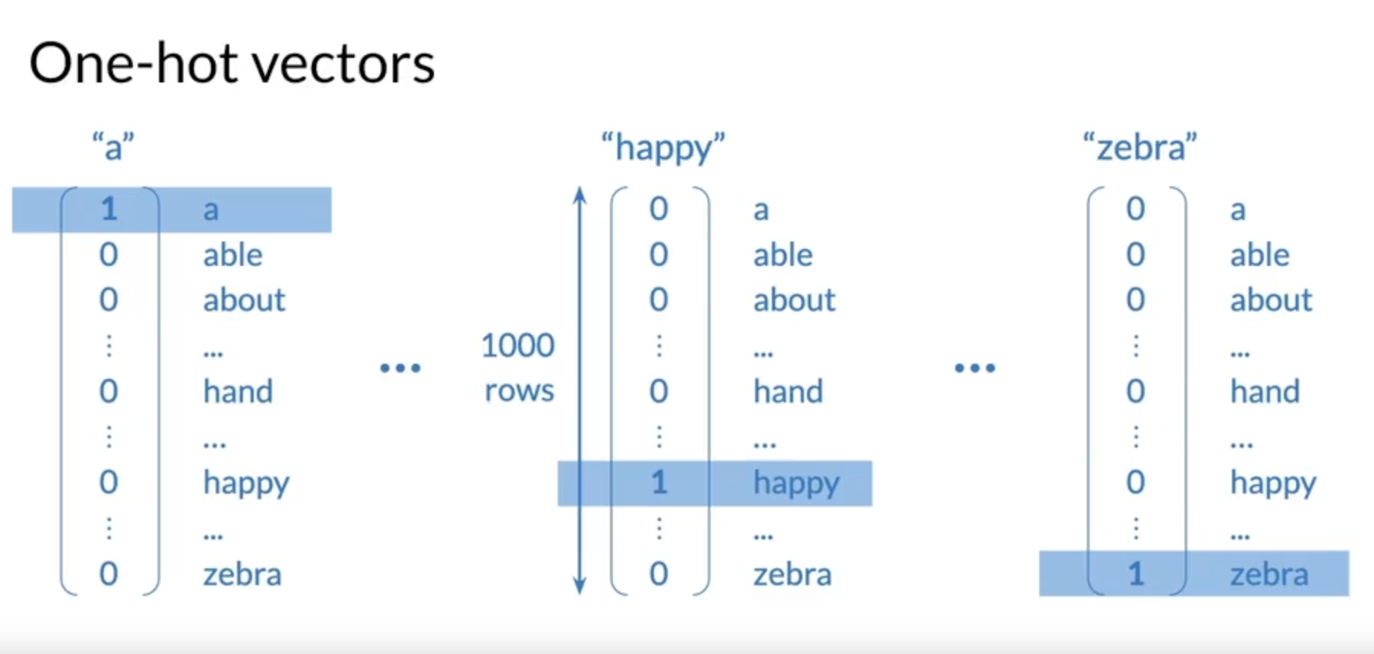
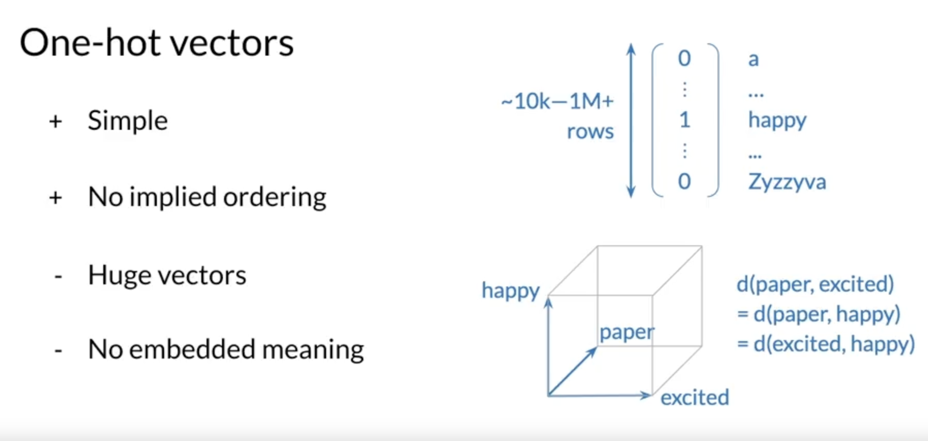
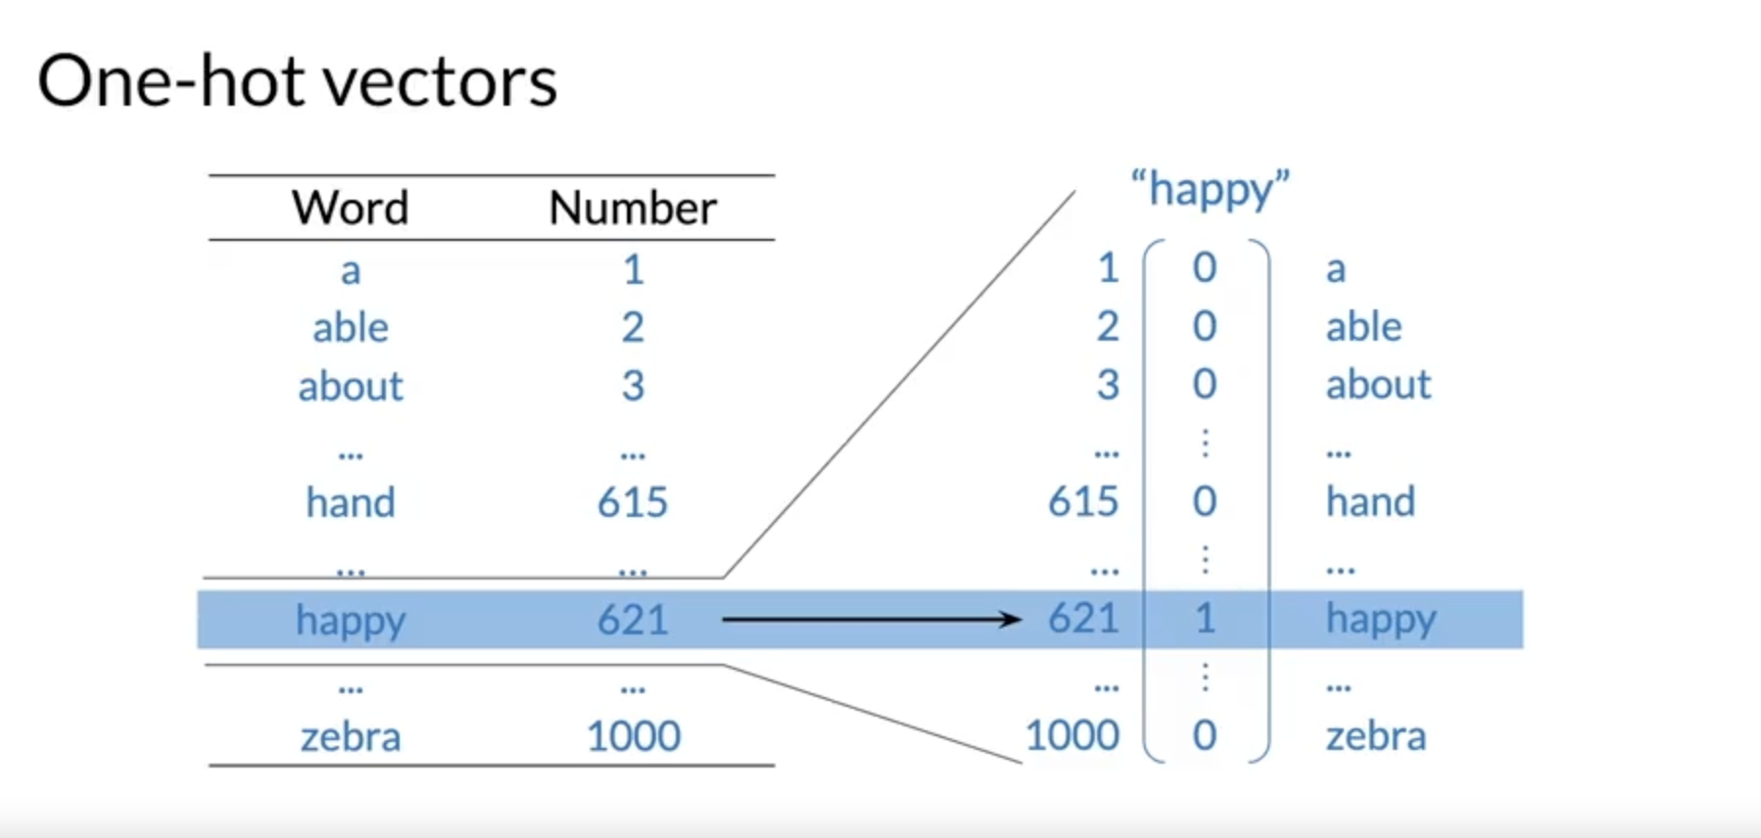
Training & Prediction
Slide credit: https://www.coursera.org/learn/probabilistic-models-in-nlp/lecture/Lkuce/basic-word-representations

Slide 3
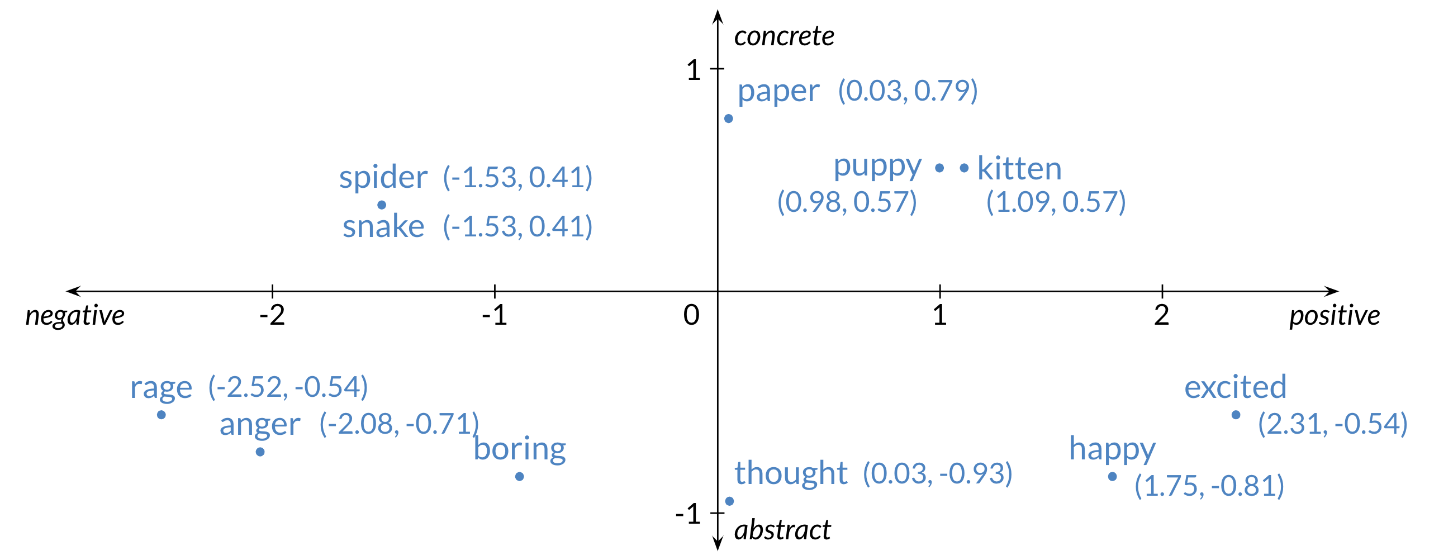
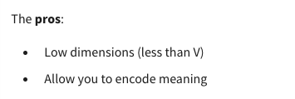
Word Embeddings
Slide credit: https://www.coursera.org/learn/probabilistic-models-in-nlp/lecture/Lkuce/basic-word-representations

Slide 4
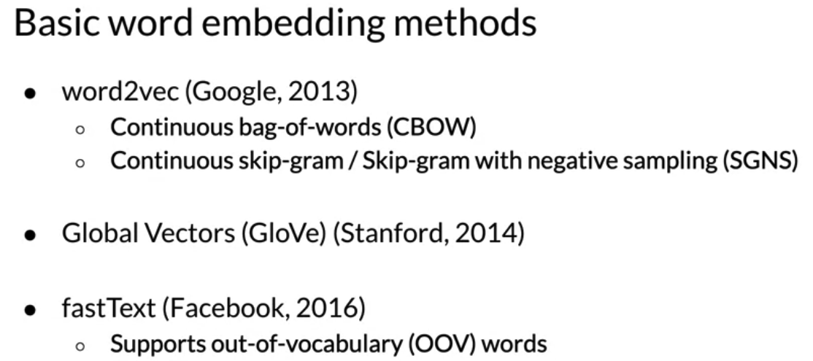
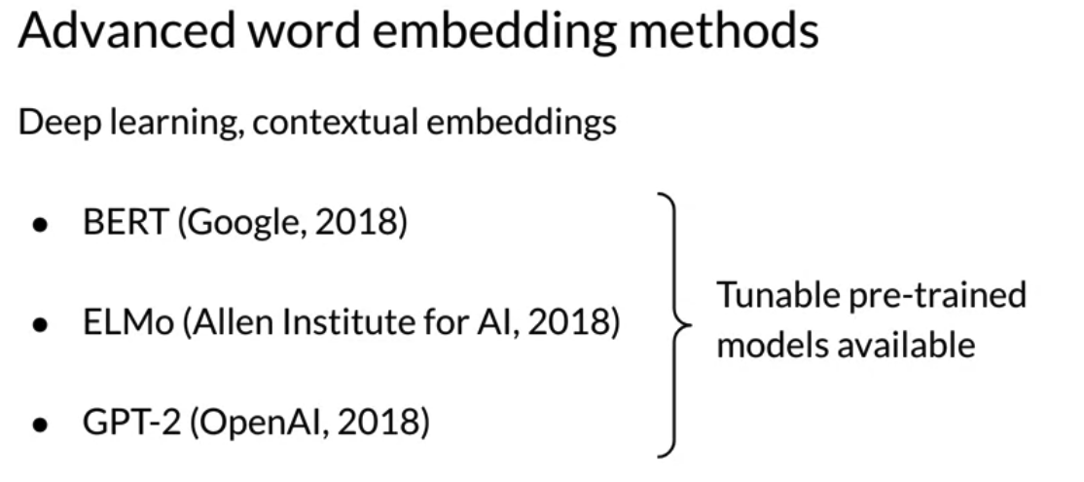
Word Embeddings
Slide credit: https://www.coursera.org/learn/probabilistic-models-in-nlp/lecture/Lkuce/basic-word-representations

Slide 5
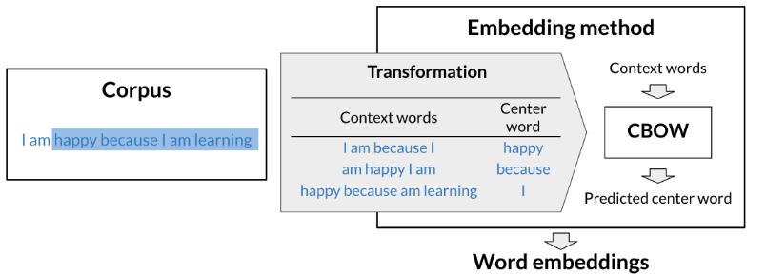
Word Embeddings
I am happy because I am learning
Context words C = 2
Window size = 5
“You shall know a word by the company it keeps” — John Rupert Firth
Slide credit: https://www.coursera.org/learn/probabilistic-models-in-nlp/lecture/Lkuce/basic-word-representations

Slide 6
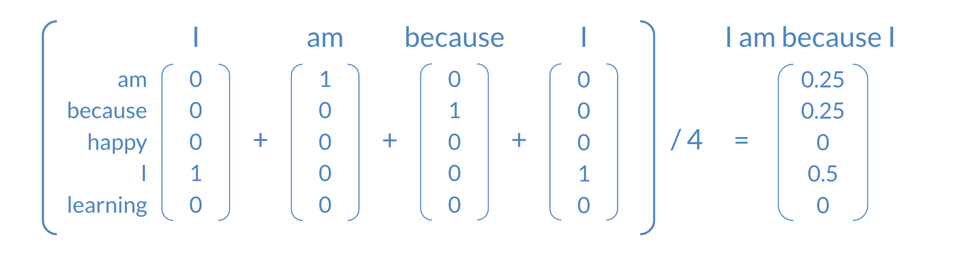
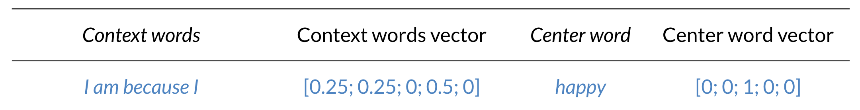
Word Embeddings
Slide credit: https://www.coursera.org/learn/probabilistic-models-in-nlp/lecture/Lkuce/basic-word-representations

Slide 7
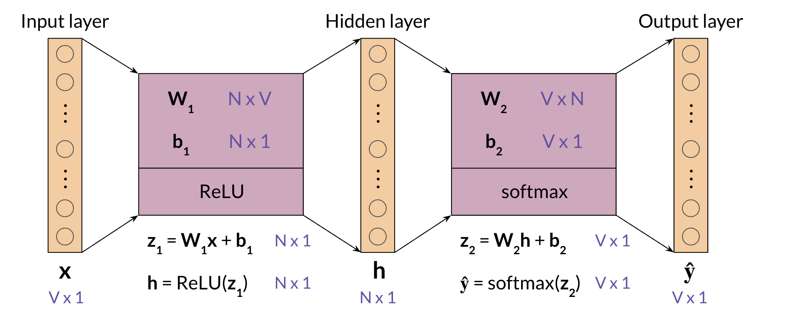
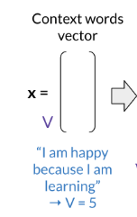
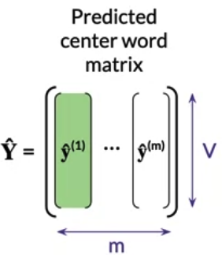
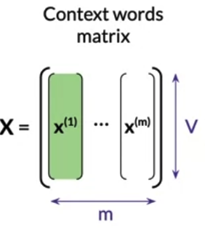
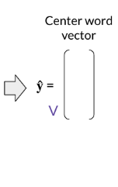
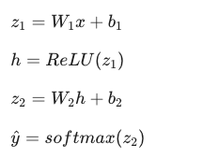
Architecture for the CBOW Model
Slide credit: https://www.coursera.org/learn/probabilistic-models-in-nlp/lecture/Lkuce/basic-word-representations

Slide 8
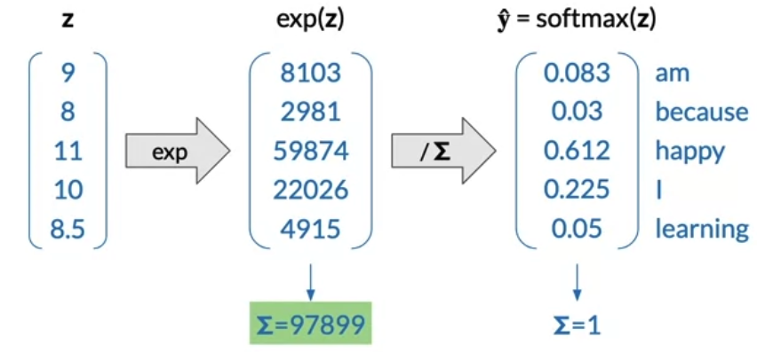
Softmax
Slide credit: https://www.coursera.org/learn/probabilistic-models-in-nlp/lecture/Lkuce/basic-word-representations

Slide 9
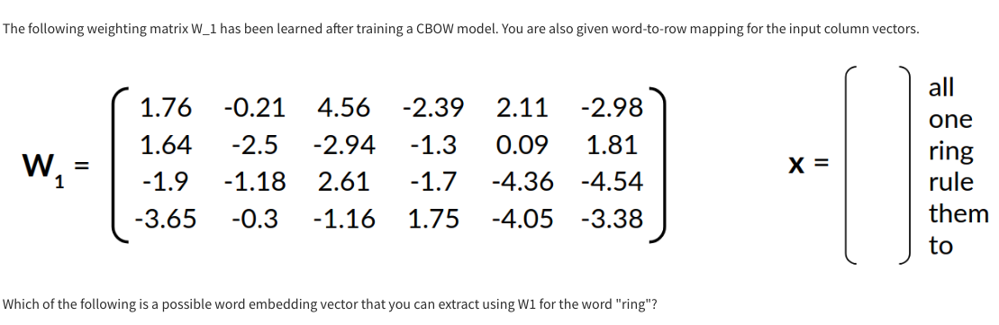
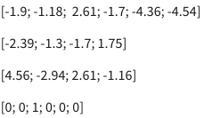
Quick Question

Slide 10
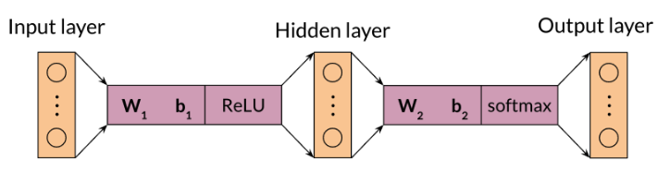
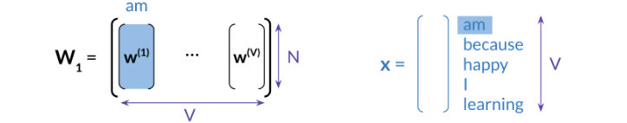

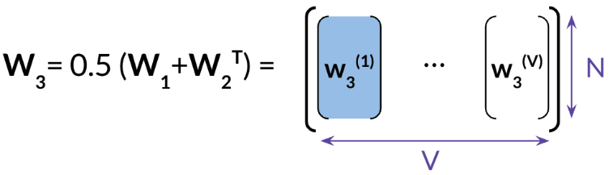
Extracting Word Embedding Vectors
Average ->

Slide 11
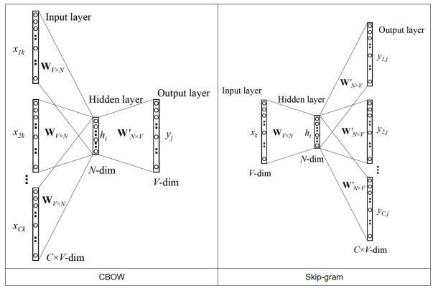
Extracting Word Embedding Vectors

Slide 12
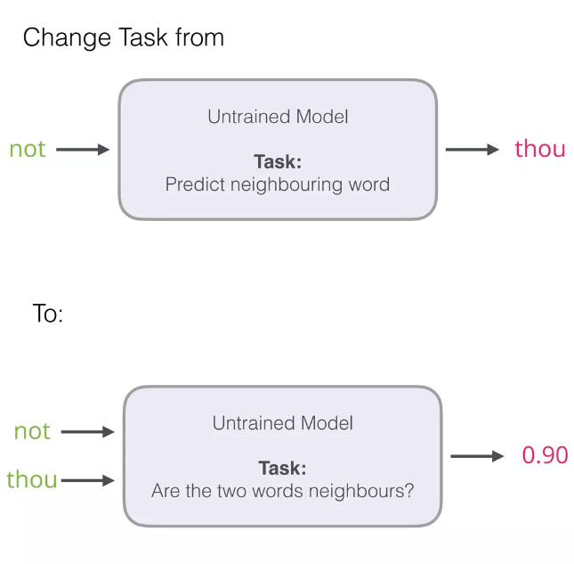
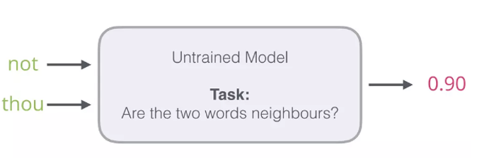
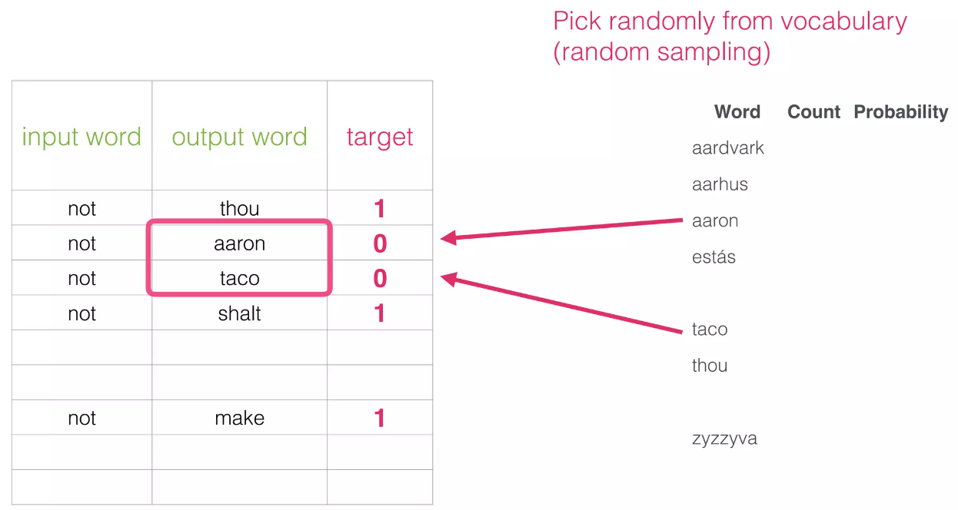
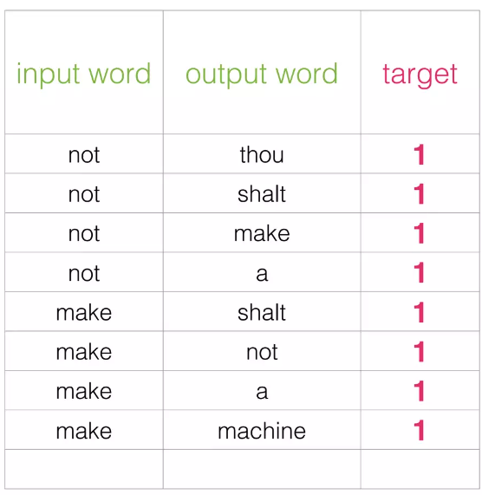
Embeddings
1
2
Word2vec Hazır ☺
Slide credit: https://www.slideshare.net/InfoQ/intuition-usecases-of-embeddings-in-nlp-beyond

Slide 13
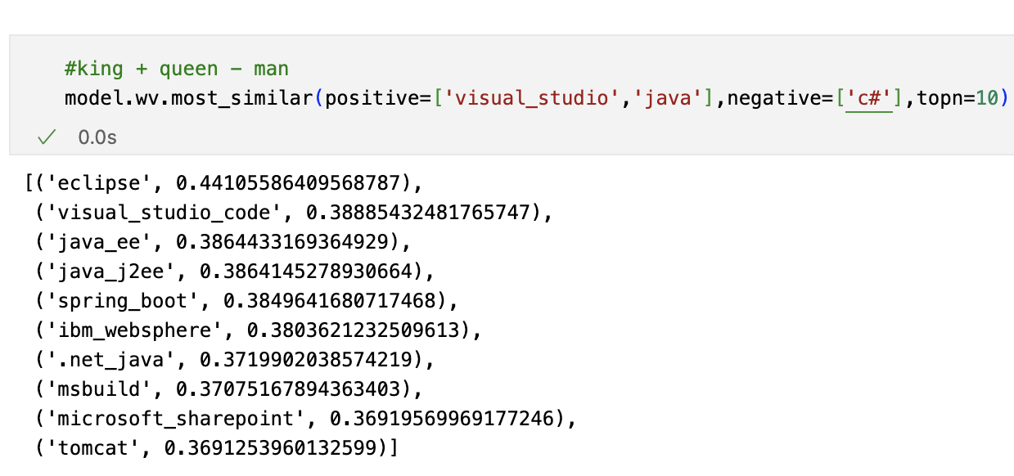
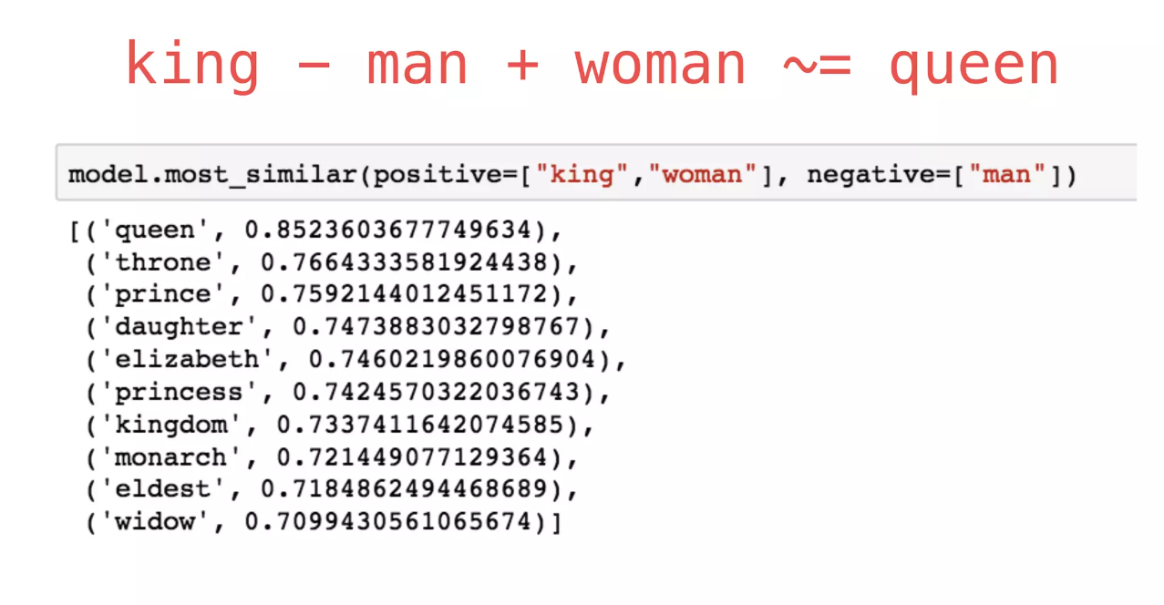
Evaluation
Instrinsic
Extrinsic
Text Classification, Named Entity Recognation etc.
Notes:
+ Evaluates actual usefulness of embeddings
- Time Consuming
- More difficult to trouble shoot

Slide 14
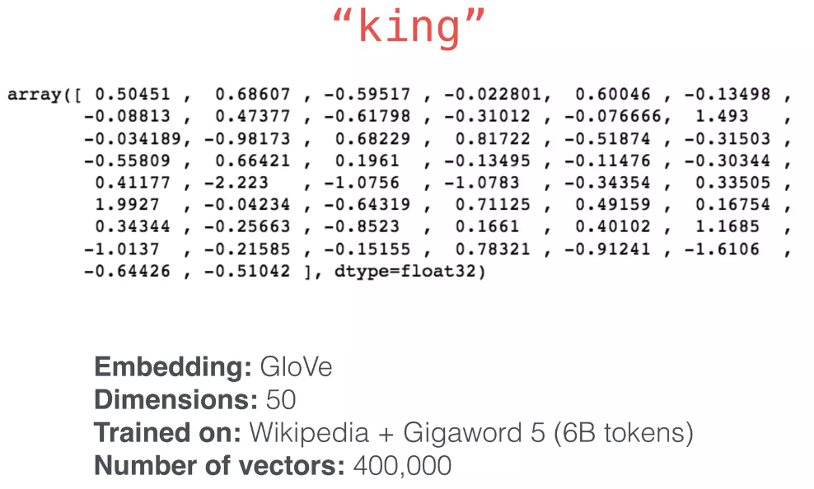
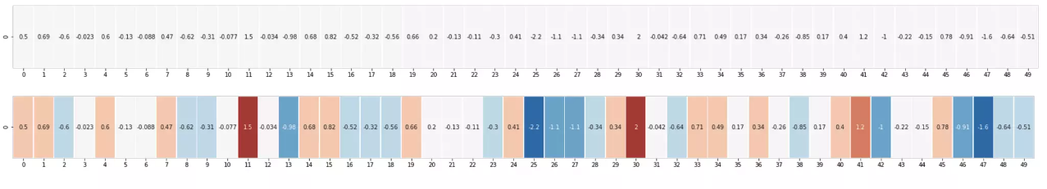
Embeddings
Slide credit: https://www.slideshare.net/InfoQ/intuition-usecases-of-embeddings-in-nlp-beyond

Slide 15
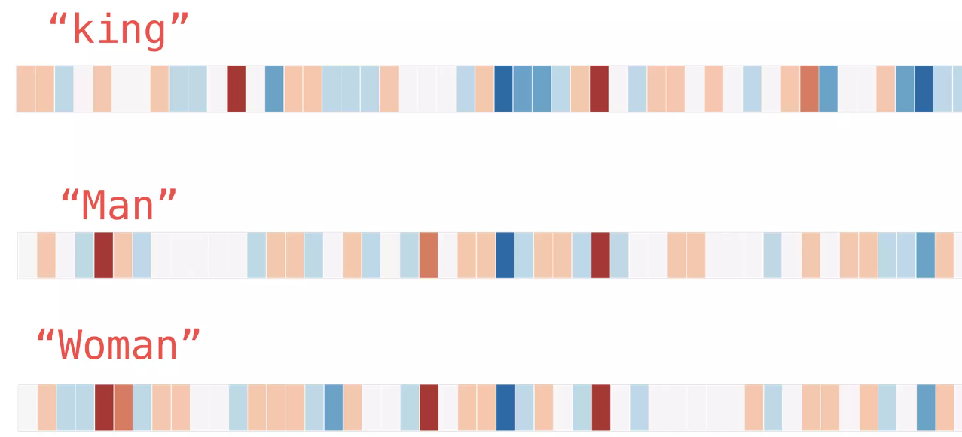
Embeddings
Slide credit: https://www.slideshare.net/InfoQ/intuition-usecases-of-embeddings-in-nlp-beyond

Slide 16
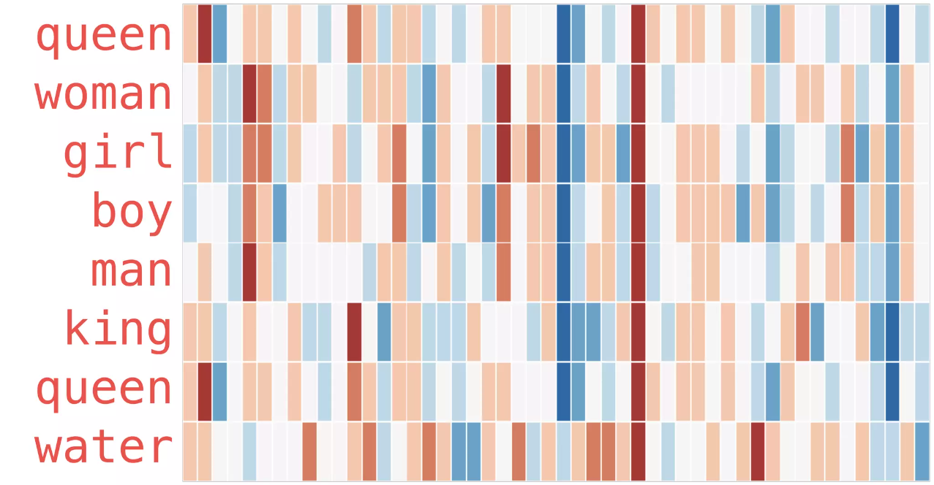
Embeddings
Slide credit: https://www.slideshare.net/InfoQ/intuition-usecases-of-embeddings-in-nlp-beyond

Slide 17

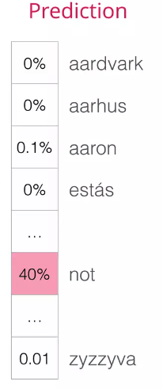
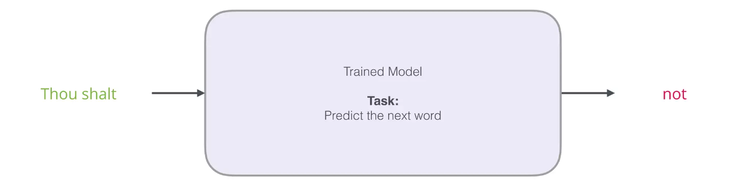
Embeddings
Slide credit: https://www.slideshare.net/InfoQ/intuition-usecases-of-embeddings-in-nlp-beyond

Slide 18
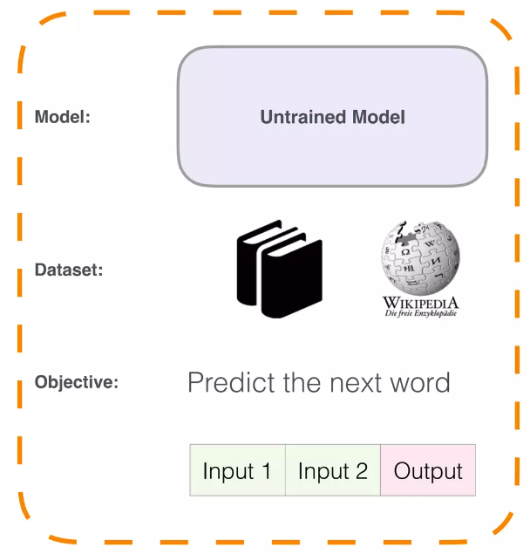
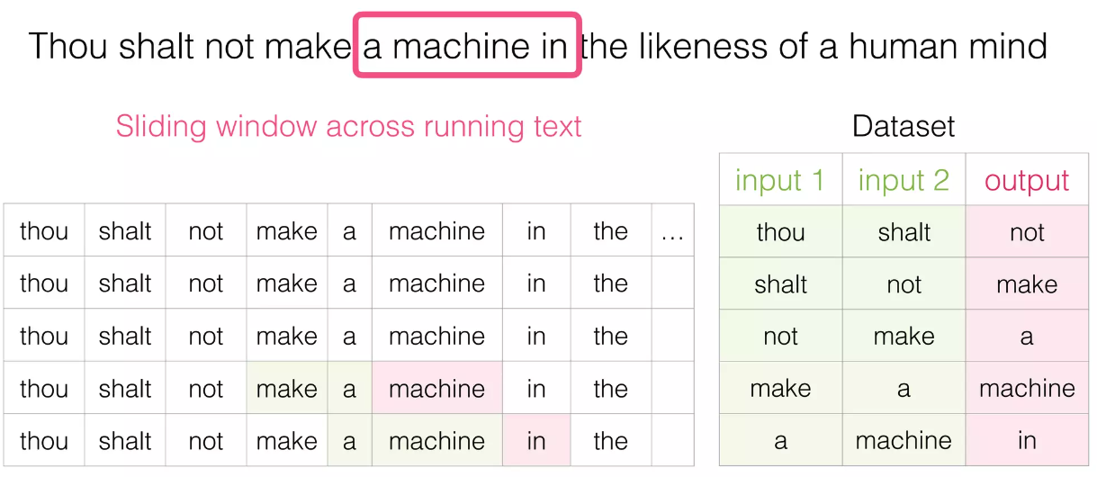


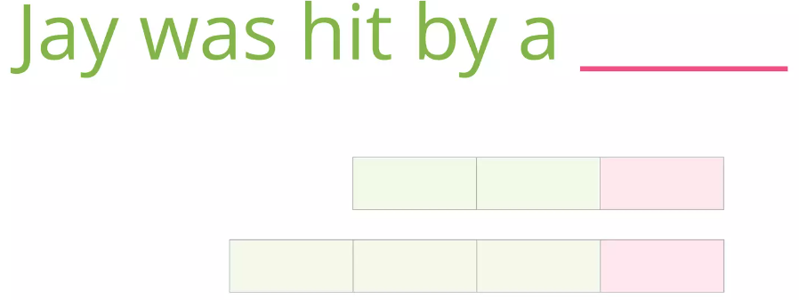
Embeddings
Slide credit: https://www.slideshare.net/InfoQ/intuition-usecases-of-embeddings-in-nlp-beyond
Notes:
Iki yönlü bakmakta bir değer var.

Slide 19
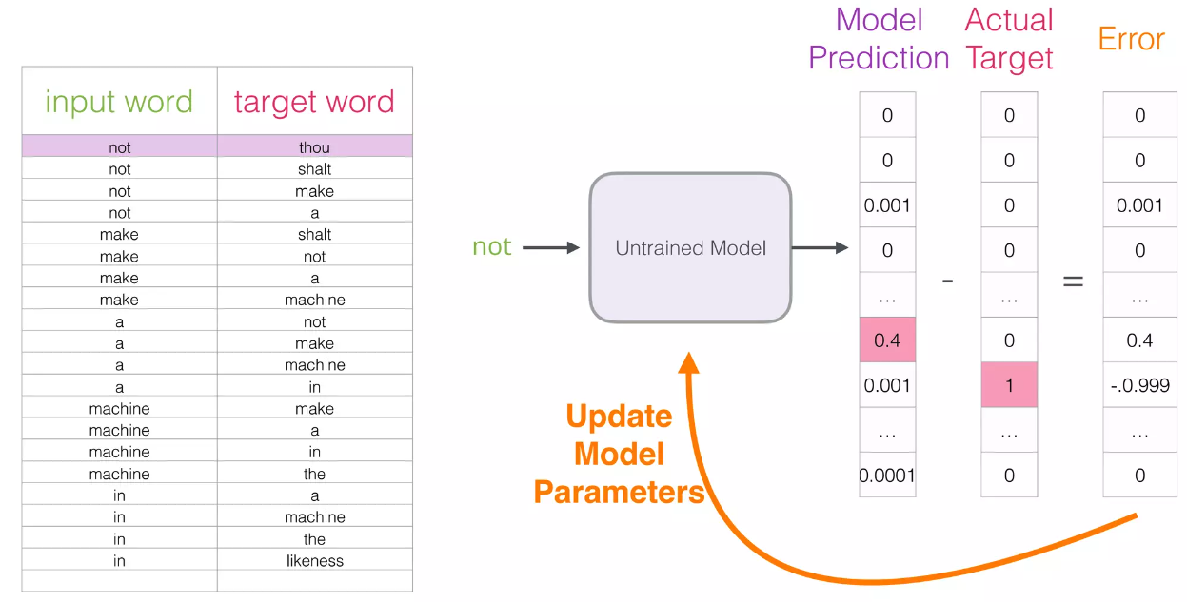
Embeddings
Computationally intensive!
Slide credit: https://www.slideshare.net/InfoQ/intuition-usecases-of-embeddings-in-nlp-beyond

Slide 20
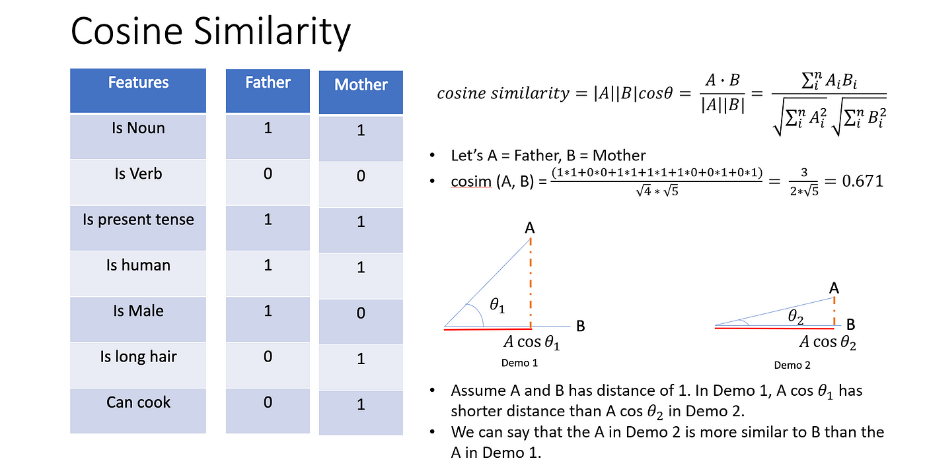
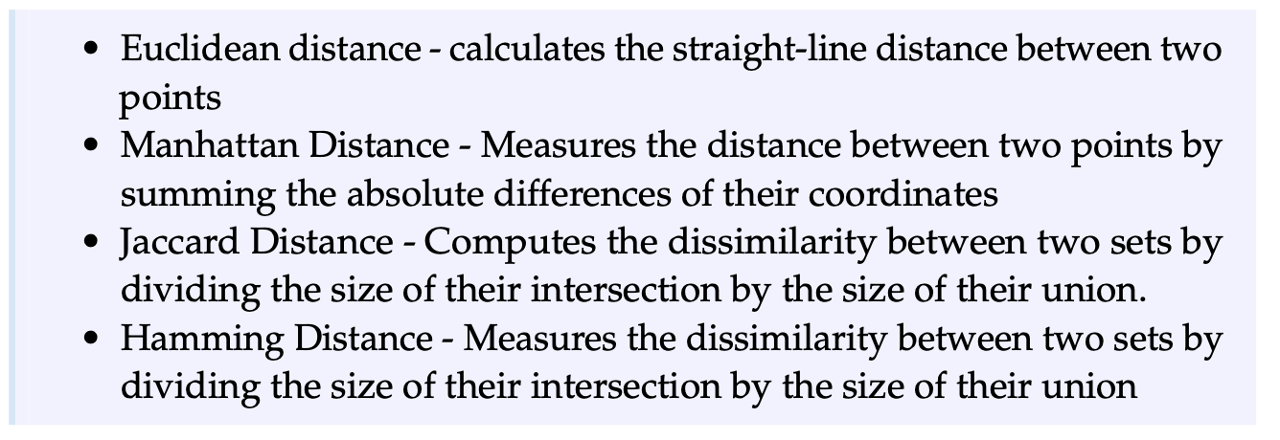
Word2Vec
Notes:
2015 yılında google lu bir mühendis..

Slide 21
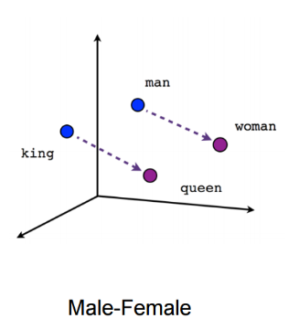
Word2Vec
“You shall know a word by the company it keeps” — John Rupert Firth
Fixed size vectors are used where the size of the vector remains constant regardless of the number of unique words in the corpus.
Semantic information is incorporated in the vector representations.
Word2Vec vectors are highly efficient at grouping similar words together.
The algorithm estimates the similarity of words based on their position in the corpus.
Words with similar meanings have similar vector representations. For instance, "Kid" and "Child" are similar words, and their vector representations will be similar.
Notes:
2015 yılında google lu bir mühendis..

Slide 22
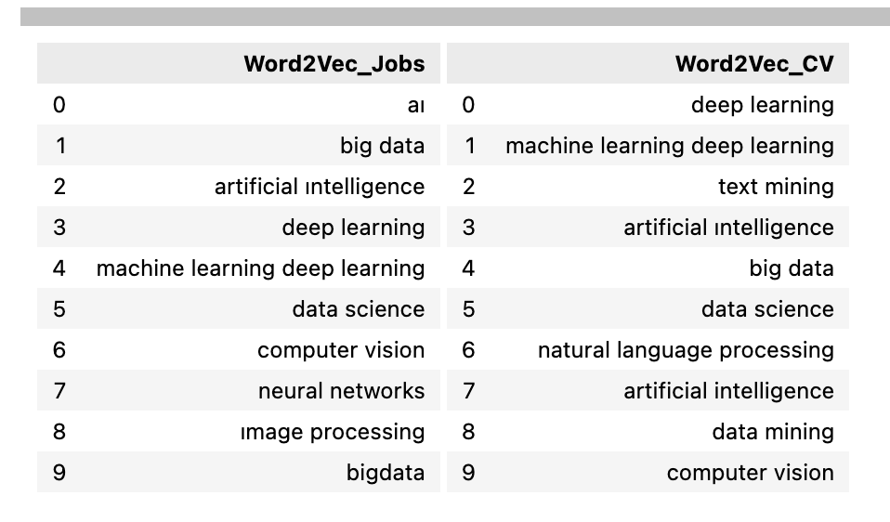
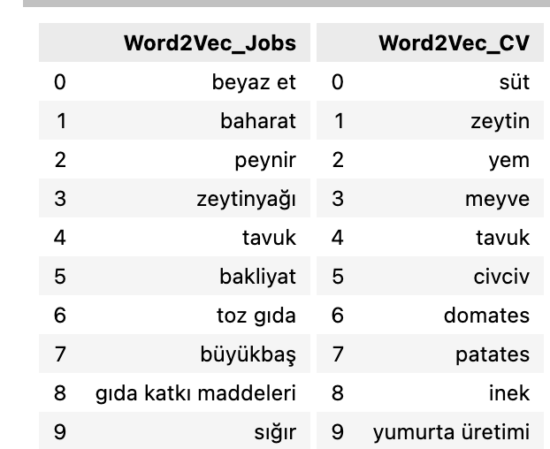
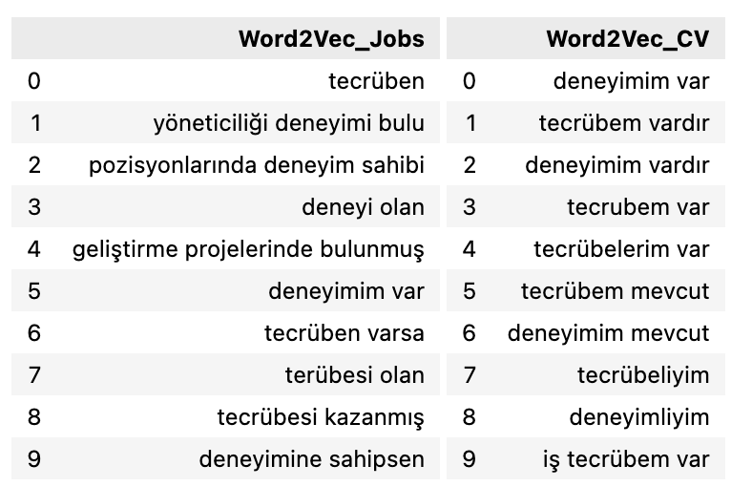
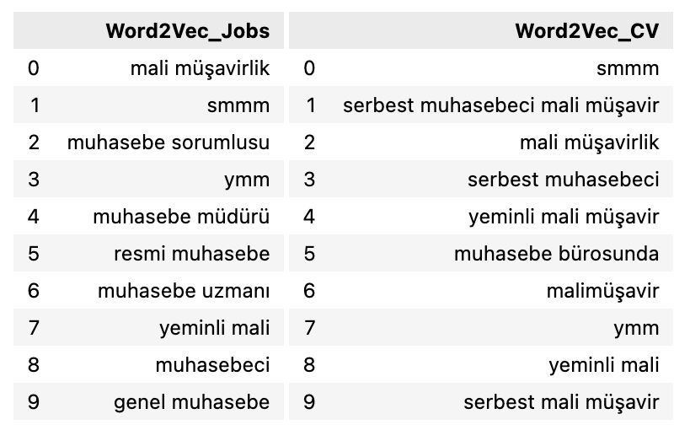
Word2Vec
Notes:
2015 yılında google lu bir mühendis..

Slide 23
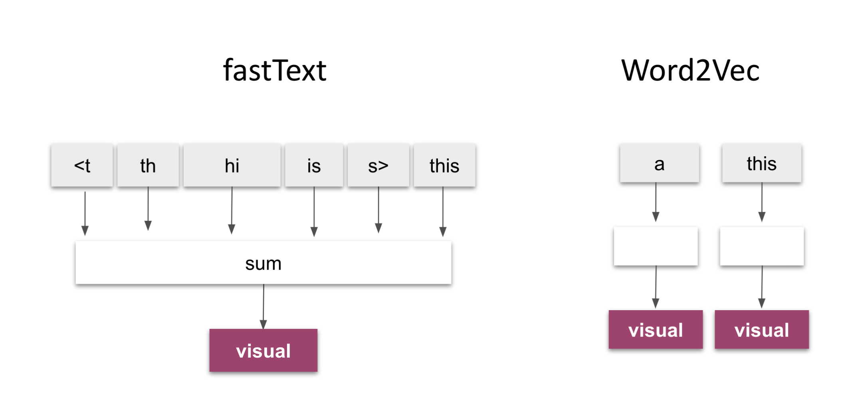
Word2Vec
Pretrained Embeddings : GLOVE, Google Word2vec
FastText -> Facebook – char based
Notes:
Bir sürü text preprocessing tyapıyoruz feature extraction filan da..

Slide 24
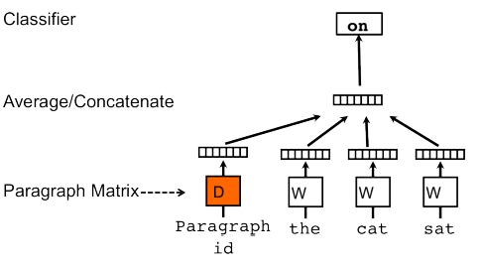
Doc2Vec
After this idea is proved to be effective and helpful, say, you can easily cluster and find similar words in a huge corpus, people then began thinking further: is it possible to have a higher level of representation on sentences, paragraphs or even documents.
Doc2Vec is an algorithm that learns to represent documents as fixed-length vectors. It does this by training a neural network to predict the words in a document based on its context (similar to word2vec).
In addition to predicting words, the network also learns a vector representation for each document in the corpus. This is done by adding a unique "document ID" to each word in the document,
After training, you can use the vectors learned by Doc2Vec to perform various tasks, such as document classification, similarity search, or clustering. The vectors are often more useful than traditional bag-of-words representations, as they capture not only the words in the document, but also its overall meaning and context.
Notes:
Bir sürü text preprocessing tyapıyoruz feature extraction filan da..

Slide 25
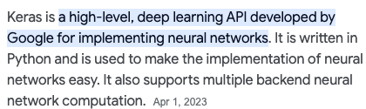
Embeddings – Keras
Word2Vec
Pre-trained word embeddings
Also can be done along with model
What is the embedding layer in Keras?
CODING TIME!!

Slide 26
Projeler
İlan Metin Üretimi
Toxicity Tahmini
İlanların İçerisinden lokasyon, üniversite adı, bölüm, tarih, yetenek gibi kavramların çıkartılması,
İş ilanlarının özetlenmesi
İş arama motoru
Soru - cevap motoru
İlan Öneri Motoru

Slide 27
THE END
Thanks

